Slide 1
Case Project: Media & Technology
Unveiling Insights from YouTube Data: An Analytical Approach

Slide 2
INTRODUCTION
In this world of ever-evolving online content landscape, Youtube has played a major role. We will gain data insights and explore about this extraordinary dataset of Youtube giants.

Slide 3
Top 10 youtube channels
1] T-Series | 245 M
2] YouTube Movies | 170 M
3] MrBeast | 166 M
4] Cocomelon - Nursery Rhymes | 162 M
5] SET India | 159 M
6] Music | 119 M
7] ýýý Kids Diana Show | 112 M
8] PewDiePie | 111 M
9] Like Nastya | 106 M
10] Vlad and Niki | 98.9 M

Slide 4
The category with highest number of average subscribers is ‘shows’ with subscribers count of 41,615,385
Interesting Fact ….
‘Show’ category include channels like SET India , Sony SAB , Colors TV , Masha and The Bear , Sony PAL , Mr Bean and many more…

Slide 5
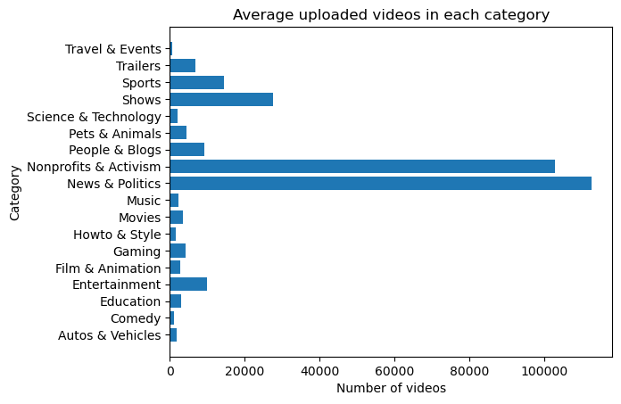
Videos, on average uploaded by YouTube channels in each category
From the figure, it is visible that the categories News & Politics and Nonprofits & Activism have a high number of videos uploaded on average

Slide 6
top 5 countries with the highest number of YouTube channels are…
Country | Number of Youtube channels
United States | 435
India | 167
Brazil | 62
United Kingdom | 43
Mexico | 33

Slide 7
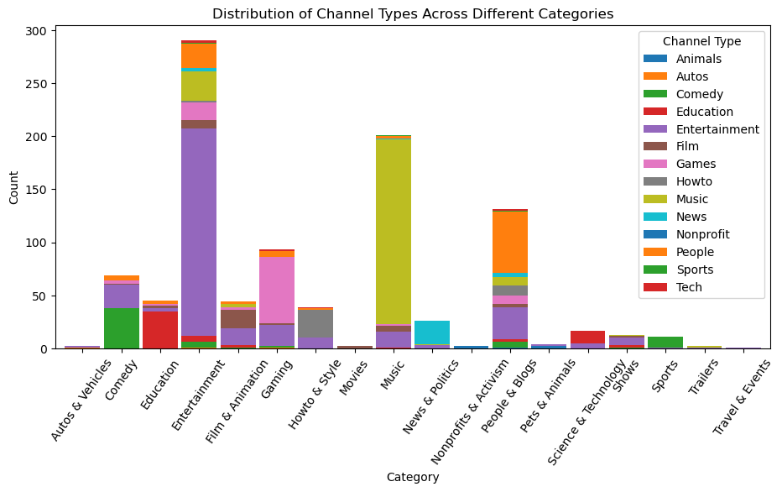
distribution of channel types across different categories
Entertainment category has the highest count of channels and hence is popular among others.
Categories like music and people & Blogs also have high no. of channels after entertainment.
Then we have the Gaming category which is rising fast along with comedy category.
We also need to know that there are channel types overlap, ex. Games channel type comes in category Gaming, Entertainment, etc.

Slide 8
IS THERE Correlations Between…
Number of subscribers and total video views for YouTube channels
Number of subscribers and the population of a country
Number of subscribers gained in the last 30 days and the unemployment rate in a country
Let’s find out ! →

Slide 9
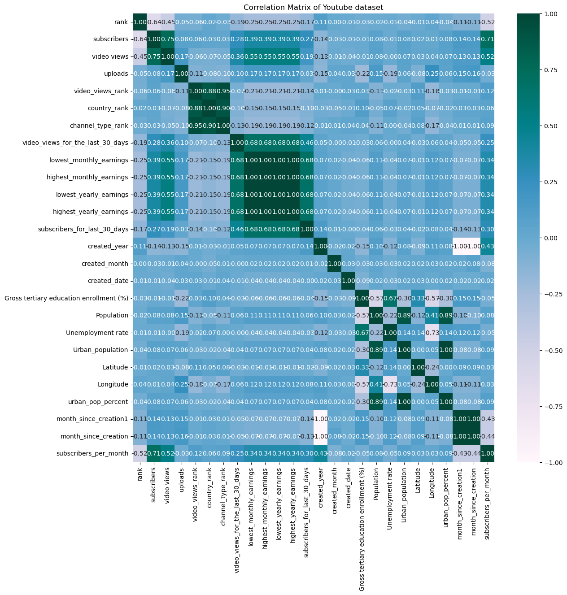


Number of subscribers and total video views for YouTube channels
Correlation Coefficient = 0.75
→ Hence, there is moderate-to-good correlation between number of subscribers and video views.

Slide 10
Number of subscribers and the population of a country
Correlation Coefficient = 0.354
→ Implies a moderate correlation between number of subscribers and population of a country
General trend :
0.3 to 0.7 is moderate correlation - suggests a noticeable, but not perfect,
relationship.
0.1 to 0.3 is weak correlation which suggests a faint relationship that might
not be practically significant

Slide 11
Number of subscribers gained in the last 30 days and the unemployment rate in a country
Correlation Coefficient = 0.211
→ Implies a weak correlation between number of subscribers gained in the last 30 days and unemployment rate in a country

Slide 12
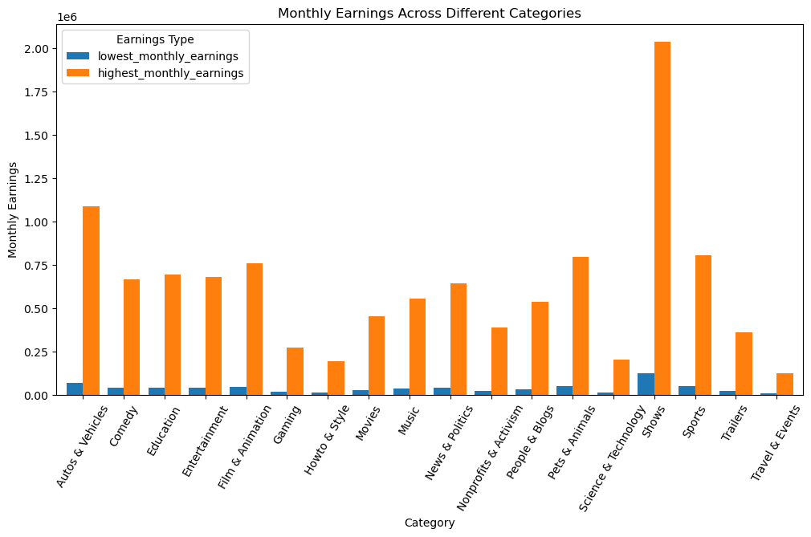
monthly earnings throughout different categories
Highest monthly earnings is highest for the category ‘Shows’ and lowest for ‘Travel & Events’
Lowest monthly earnings is highest obviously for the category ‘Shows’ and lower for ‘Howto & Style’ , ‘Science & Technology’ categories and lowest for ‘Travel & Events’ category
From the above info, we can say that the category with highest monthly earning is ‘Shows’ and lowest monthly earning is ‘Travel & Events’

Slide 13
overall trend in subscribers gained in the last 30 days across all channels
On average, each channel gained approximately 299,086 subscribers in last 30 days
Standard deviation value indicates high variability in the number of subscribers gained
The minimum number of subscribers gained is 1 for ofcourse the channel with least growth
The maximum number of subscribers gained is 8000,000 i.e., 8 million for the channel with highest growth
The first quartile i.e., 25% of the channels gained 100,000 subscribers or lesser
The median number of subscribers gained is 200,000 i.e., half of the channels gained 2 lakh subscribers
75% of the channels gained 2 lakh subscribers or lesser

Slide 14
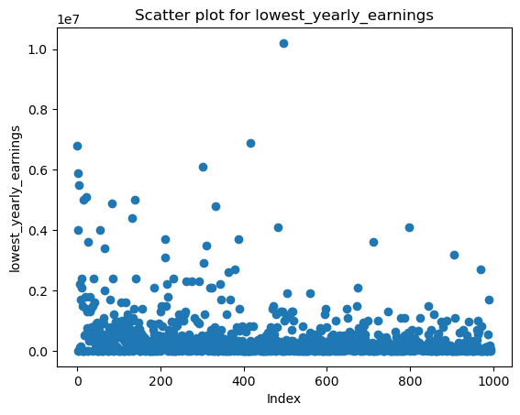

outliers in terms of yearly earnings from YouTube channels
From the above scatter plots we can clearly see that there are some outliers in terms of yearly earnings from youtube channels due to some exceptionally good and popular channels that have commendable growth in their category like T-Series, YouTube Movies, etc.

Slide 15
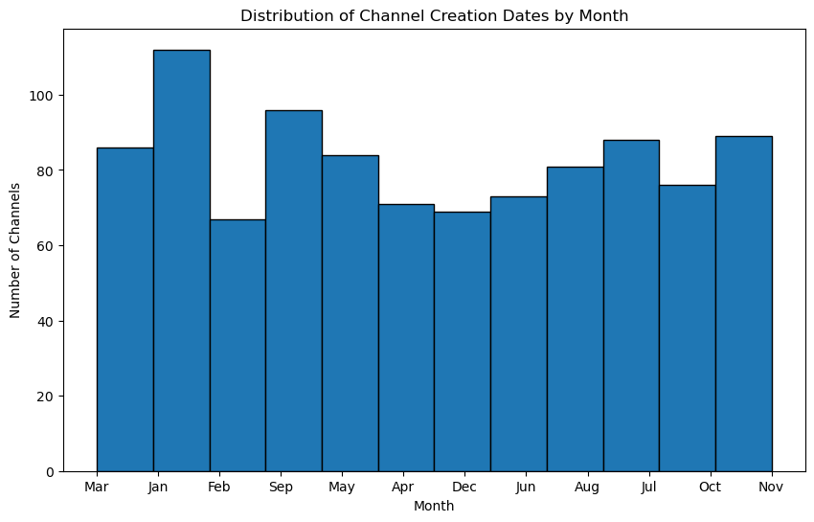
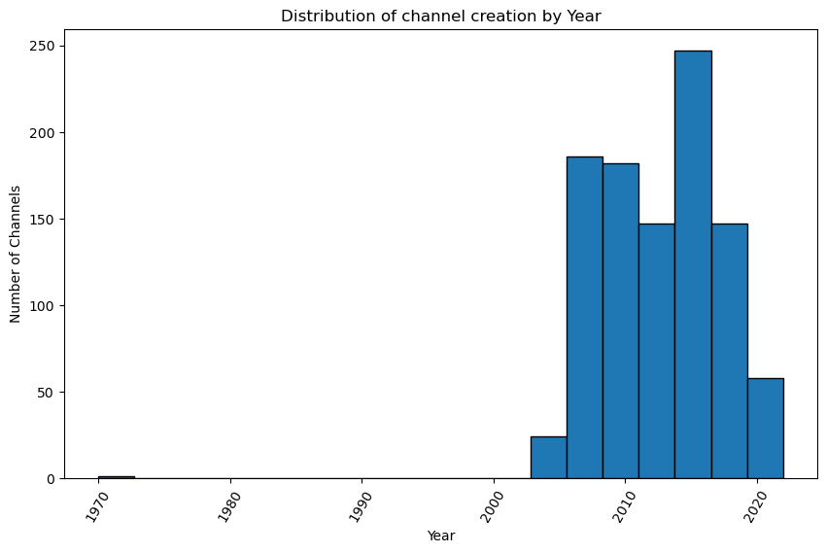
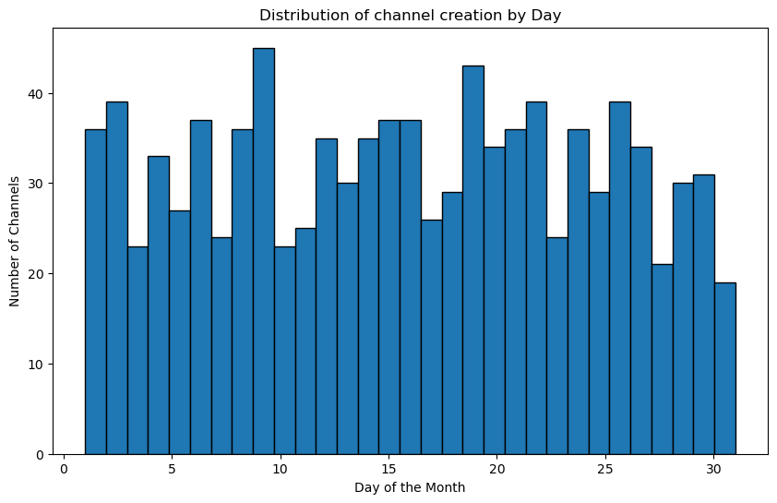
distribution of channel creation dates – Trend over time
There is not a proper trend in channel creation over months, but comparably in Jan more no. of channels are created
The earliest channel is ofcourse of youtube in 1970
After 2005, the creation of channels increased gradually
In 2006, it shoot up and then became somewhat stable
Around 2013-14 it again took a higher jump and then decreased slowly
There is no clear or consistent trend in channel creation over days of the month.
No. channels created vary considerably

Slide 16
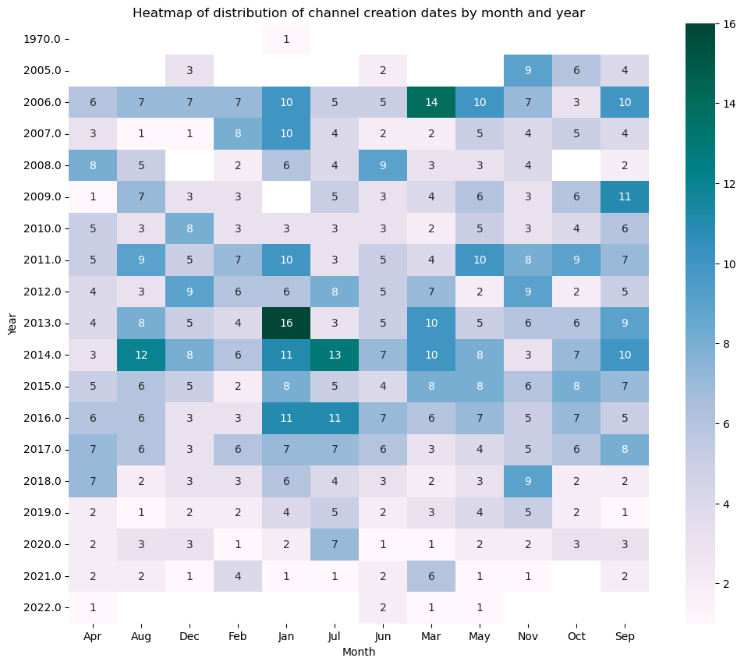
distribution of channel creation dates – Trend over time
Heatmap showing distribution of channel creation by month and year
Key highlights :
16 channels were created in Jan, 2013
14 channels were created in Mar, 2006
13 channels were created in Jul, 2014
12 channels were created in Aug, 2014
And so on…

Slide 17
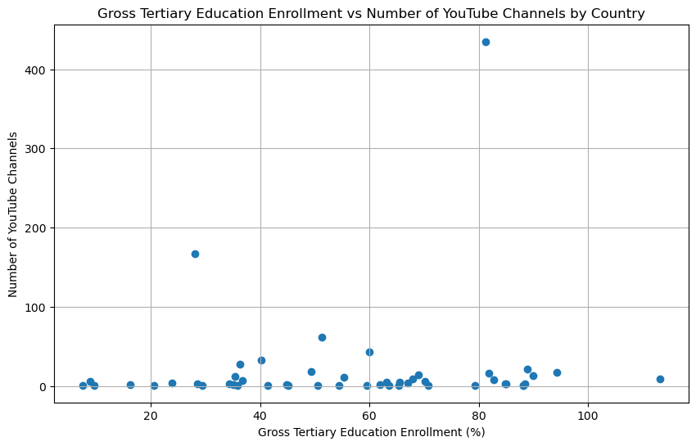
relationship between gross tertiary education enrollment and the number of YouTube channels in a country
The correlation coefficient between the two is less, implying close to no relation between gross tertiary education enrolment and no. of youtube channels in a country
Also from the scatter plot you can see that the points are widely spread with no clear pattern
Significant outliers like countries with 400+ channels having gross tertiary education enrolment of around 80%

Slide 18
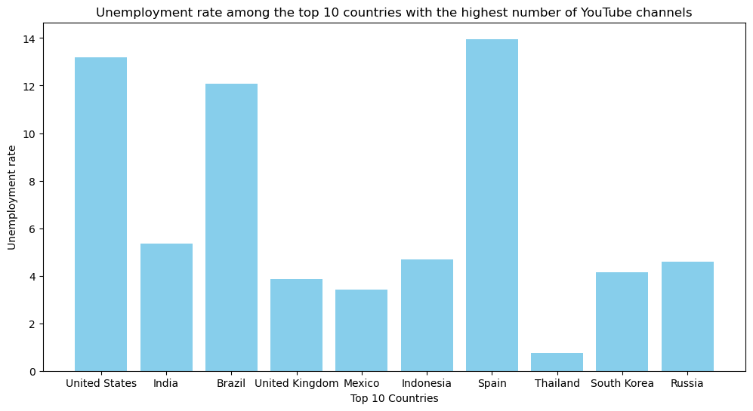
unemployment rate among the top 10 countries with the highest number of YouTube channels
There is not a proper trend or pattern in the unemployment rate for the top 10 countries with highest no. of channels.
US being the country with highest no. of channels having the unemployment rate close to 13%.
Spain being the country having highest unemployment rate close to 14%.

Slide 19
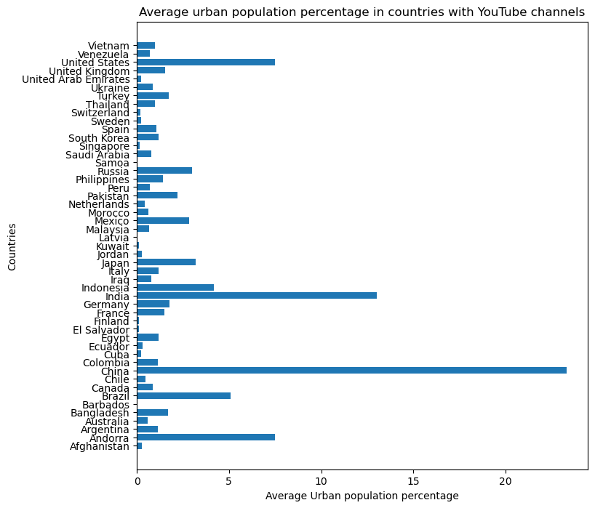
average urban population percentage in countries with YouTube channels
Key highlights :
China has the highest urban population
Then we have India with 2nd highest urban population
After that we have US and Andorra with 3rd highest urban population

Slide 20
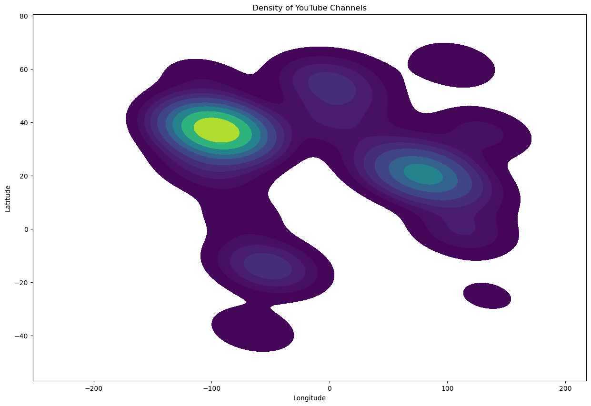
distribution of YouTube channels based on latitude and longitude coordinates
The part with yellow shaded region is US and is also correct because we know that highest number of channels are from the country US
The greenish part region somewhere around latitude(20) and longitude(90) is Indian which makes sense as it is 2nd most country having a large no. of youtube channels after US
Dark Blue/Purple: Represents areas with the lowest density of points.
Green: Represents areas with a medium density of points.
Yellow/White: Represents areas with the highest density of points.

Slide 21
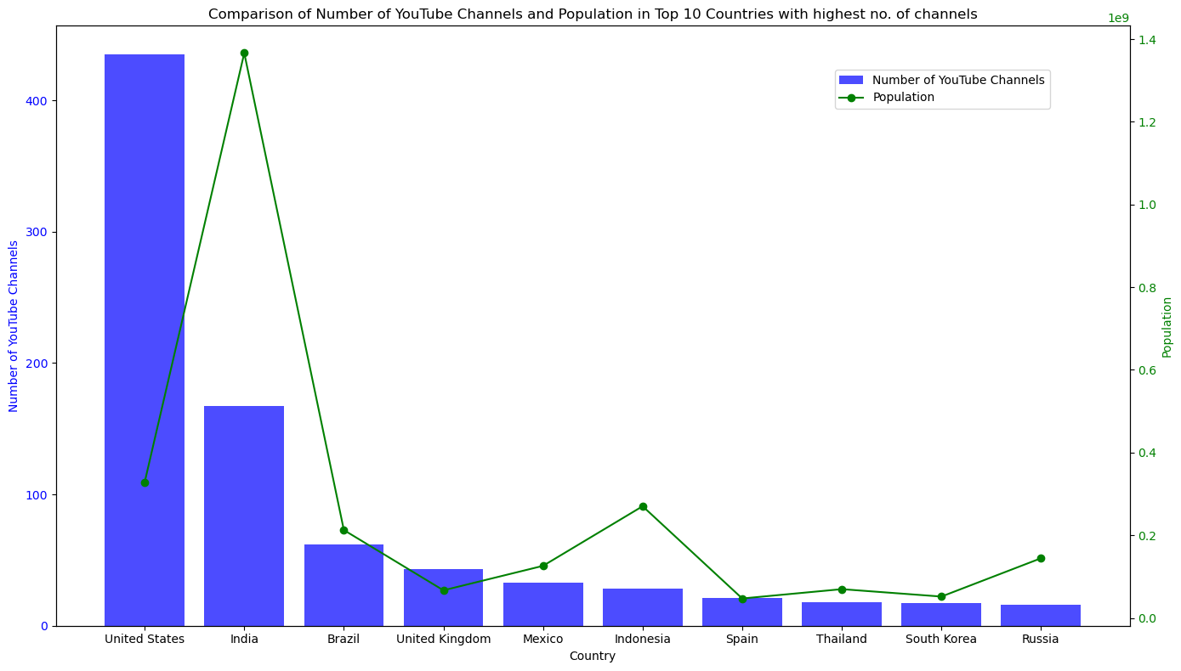
comparing top 10 countries with highest number of YouTube channels in terms of their total population
The United States has a disproportionately high number of YouTube channels relative to its population.
India, with the highest population, has significantly fewer YouTube channels than the United States, highlighting a disparity in digital content creation.
Countries like India, Indonesia, Brazil, and Mexico with large populations but relatively fewer YouTube channels, could be potential growth markets for YouTube content creation.
Western countries (US, UK) have a higher concentration of YouTube channels compared to Eastern countries (India, Indonesia) when adjusted for population.

Slide 22
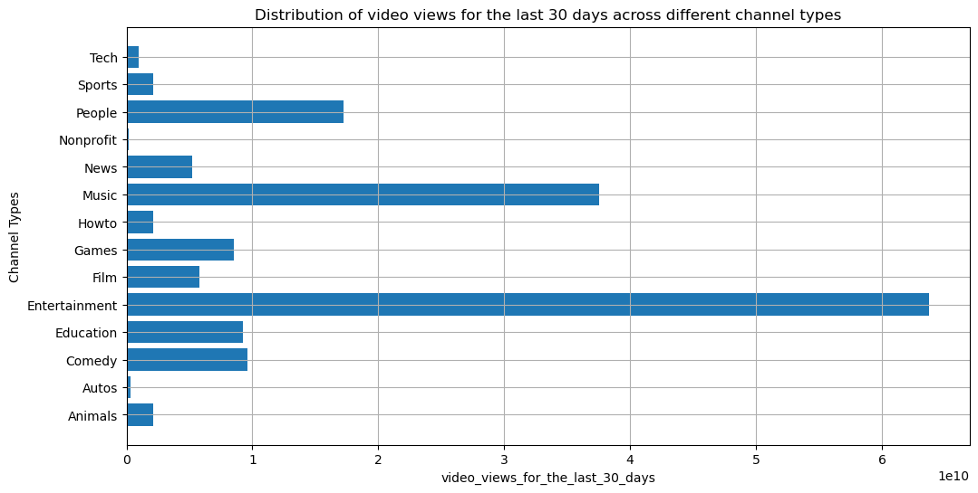
distribution of video views for the last 30 days across different channel types
Entertainment and Music dominate in terms of views, which aligns with the general trend of these types of content being highly engaging and widely shared.
Categories like Tech, Autos, and Nonprofit have smaller view counts but cater to more specific niche audiences who are interested in these topics.
The diversity in view counts across different categories indicates a broad spectrum of interests among YouTube viewers.

Slide 23
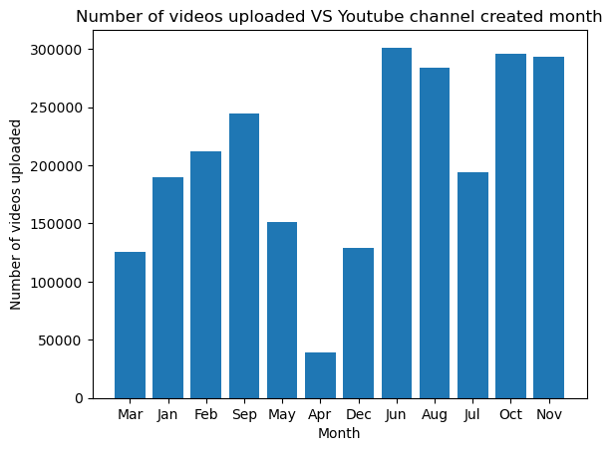
seasonal trends in the number of videos uploaded by YouTube channels
High Activity Periods: Summer and Fall (June, August, October, November): These months generally show higher activity in terms of video uploads. This might be due to the fact that summer months often see more leisure time and vacations, leading to more content creation. Fall months might see a spike due to the return to routine schedules, potentially more planning and execution of content.
Low Activity Periods: December and May: These months are outliers with significantly lower activity. December might see a dip due to the holiday season, where people are less focused on content creation.
May could be a transitional month, marking the end of spring and the beginning of summer, leading to less activity.
Transitions: April: Being just before summer, April might be a planning phase for many creators, leading to fewer uploads.
July: Despite being a summer month, it shows lower uploads compared to June and August, which could indicate mid-summer vacations or a temporary lull in activity.

Slide 24
average number of subscribers gained per month since the creation of YouTube channels till now is approximately “184,875” → (185K)
Interesting Fact ….

Slide 25
Summary
This analysis of the YouTube dataset reveals significant trends in content creation, viewership, etc. The US leads in the number of channels, but emerging markets like India, Brazil and UK show substantial growth potential.
The insights discussed in this presentation can guide strategic decisions for current and upcoming content creators and platform enhancements for YouTube, ensuring continued growth and engagement across diverse audiences.

Slide 26
THANK YOU
Soham Rahatal
sohamrahatal@iitgn.ac.in
B.Tech, IIT Gandhinagar

